Slide 1
Team Robot Mentor Meeting 2016/1/29
ESE Robot Team
Liwen Chang
Chien-An Chen
Shunji Cheng
Xiaoyi Ge
Tongkai Shao

Slide 2
Outline
Stakeholders
Business goals
High-level requirements
Business constraints
Technical constraints
Quality attributes
Project Schedule
Process Model

Slide 3
Stakeholders
Tony (Client)
Dan (Consultant)
Robot Team (us)
Users

Slide 4
Business Goal
From client:
“The goal is to build a general purpose, mobile robot, designed to meet needs of engineers and researchers in industry, government, and academia.”

Slide 5
High-level Requirements (1)
The system shall enable a developer to use their own laptop to connect (and make commands) to the robot.
The system shall provide simple communication protocol between laptop and robot platform.
The system shall provide API which allows programmers to access to the robot services.
The system shall provide the basic robot motion control.
The system shall have the basic collision detection function.

Slide 6
High-level Requirements (2)
The system shall have the ability of error management.
The system shall support power monitoring.
The team shall prepare a comprehensive demo.
The team shall provide a complete system test plan, user guide and API documentation.

Slide 7
Business constraint
Budget is about $500.
Deliver before the end of summer semester.

Slide 8
Technical constraints
Use sonar sensor for collision detection.
Use USB as connection between laptop and robot.
Use a 12V/60A deep marine battery as power supply.
Use two high power drive motors and existing motor control hardware for robot propulsion.
The API shall support Java.
Use Tony’s existing robot platform as a development foundation.

Slide 9
Quality attributes
a. Safety - if unsafe, just stop [NO.1]
b. Availability - stable connection between laptop and robot
c. Reliability - cannot miss operations; follow the command correctly
d. Performance - constant latency between laptop and robot
Notes:
Test the API to judge the Quality Attributes
Online Documentation
Stress Test - full speed / people walking

Slide 10
Project Schedule
Date | Milestones
Jan. 31 | Make decisions of high-level requirements, constraints, and quality attributes Refine them according to the advise from client and mentor
Feb. 7 | Create specific requirements of each system module Start to work on use cases and state charts.
Feb. 14 | Continue the design of use cases and state charts Start to play “real stuff” of robot (make some small experiments)
Feb. 21 | Finish the design of use cases and state charts Get familiar with robot and consider about other design details
Feb. 28 | Create PPT for presentation (3/1 or 3/3) and get prepared
Mar. 6 | Enjoy the spring break
… | …
Notes:
Experiment this week
PCB Tony involved
might not 2 processors

Slide 11
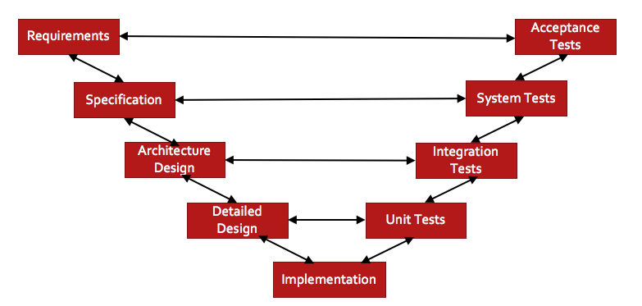
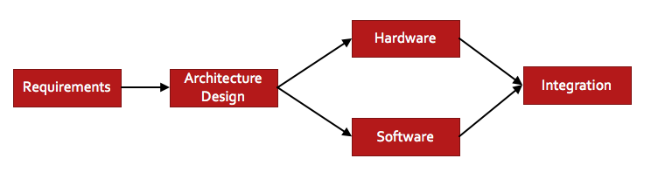
Process Model
V-model
Concurrent Development
Notes:
SW/HW

Slide 12
Thank you!

